Slide 1
Chapter 10: Storage and File Structure

Slide 2
Chapter 10: Storage and File Structure
Overview of Physical Storage Media
Magnetic Disks
RAID
Tertiary Storage
Storage Access
File Organization
Organization of Records in Files
Data-Dictionary Storage
Why is learning this important?
Notes:
Lets see the next slide for that

Slide 3

Storage Hierarchy
Notes:
You can recognize at least some of these, if not all. You may have even used most of them. So what are some of the differences between them?
So it matters where data is stored, and as a database designer, we need to be careful and aware of these differences to make appropriate decisions.

Slide 4
Classification of Physical Storage Media
Speed with which data can be accessed
Cost per unit of data
Reliability
  data loss on power failure or system crash
  physical failure of the storage device

Slide 5
Classification of Physical Storage Media
Can differentiate storage into:
  volatile storage: loses contents when power is switched off
  non-volatile storage:
    Contents persist even when power is switched off.
    Includes secondary and tertiary storage, as well as battery-backed up main-memory.

Slide 6
Physical Storage Media
Cache
  fastest and most costly form of storage
  volatile
  What are cache hits and cache misses?
  Access patterns in typical computer applications exhibit
  locality of reference
    Temporal locality example?
Notes:
locality of reference is a term for the phenomenon in which the same values, or related storage locations, are frequently accessed, depending on the memory access pattern.

Slide 7
Physical Storage Media
Main memory:
  fast access (10s to 100s of nanoseconds; 1 nanosecond = 10^{–9} seconds)
  generally too small (or too expensive) to store the entire database
    capacities of up to a few Gigabytes widely used currently
    Capacities have gone up and per-byte costs have decreased steadily and rapidly (roughly factor of 2 every 2 to 3 years)
  Volatile — contents of main memory are usually lost if a power failure or system crash occurs.

Slide 8
Physical Storage Media (Cont.)
Flash memory
  Data survives power failure (i.e. non-volatile)
  Reads are roughly as fast as main memory
  Increasingly used as a replacement for magnetic disks (called solid-state drives)
  Widely used in embedded devices such as digital cameras, phones, and USB keys

Slide 9
Physical Storage Media (Cont.)
Magnetic-disk
  Data is stored on spinning disk, and read/written magnetically
  Primary medium for the long-term storage of data; typically stores entire database
  Data must be moved from disk to main memory for access, and written back for storage
    Much slower access than main memory (more on this later)

Slide 10
Physical Storage Media (Cont.)
Magnetic-disk
  direct-access – possible to read data on disk in any order, unlike magnetic tape
  Capacities range up to roughly 1.5 TB as of 2009
    Much larger capacity and cost/byte than main memory/flash memory
    Growing constantly and rapidly with technology improvements (factor of 2 to 3 every 2 years)
  Survives power failures and system crashes
    disk failure can destroy data, but is rare

Slide 11
Physical Storage Media (Cont.)
Optical storage
  non-volatile, data is read optically from a spinning disk using a laser
  CD-ROM (640 MB) and DVD (4.7 to 17 GB) most popular forms
  Blu-ray disks: 27 GB to 54 GB
  Reads and writes are slower than with magnetic disk

Slide 12
Physical Storage Media (Cont.)
Tape storage
  non-volatile, used primarily for backup (to recover from disk failure), and for archival data
  sequential-access – much slower than disk
  very high capacity
    In 2014, Fujifilm announced a 154 TB tape cartridge
  tape can be removed from drive ⇒ storage costs much cheaper than disk
  Slowly, magnetic disks are becoming cheaper than magnetic tapes (but not there yet)

Slide 13
Storage Hierarchy (Cont.)
primary storage: Fastest media but volatile (cache, main memory)
secondary storage: next level in hierarchy, non-volatile, moderately fast access time
  also called on-line storage
  E.g. flash memory, magnetic disks
tertiary storage: lowest level in hierarchy, non-volatile, slow access time
  also called off-line storage
  E.g. magnetic tape, optical storage

Slide 14

Magnetic Hard Disk Mechanism
Over 50K-100K tracks
per platter
on typical hard disks
Typical sectors per track:
500 to 1000 (on inner tracks)
to
1000 to 2000 (on outer tracks)
NOTE: Diagram is schematic, and simplifies the structure of actual disk drives

Slide 15
Magnetic Disks
Read-write head
  Positioned very close to the platter surface (almost touching it)
  Reads or writes magnetically encoded information.
Surface of platter divided into circular tracks
  Over 50K-100K tracks per platter on typical hard disks
Each track is divided into sectors.
  A sector is the smallest unit of data that can be read or written.
  Sector size typically 512 bytes
  Typical sectors per track: 500 to 1000 (on inner tracks) to 1000 to 2000 (on outer tracks)

Slide 16
Magnetic Disks
To read/write a sector
  disk arm swings to position head on right track
  platter spins continually; data is read/written as sector passes under head
Head-disk assemblies
  multiple disk platters on a single spindle (1 to 5 usually)
  one head per platter, mounted on a common arm.
Cylinder i consists of i^{th} track of all the platters

Slide 17
Magnetic Disks (Cont.)
Earlier generation disks were susceptible to head-crashes
  Surface of earlier generation disks had metal-oxide coatings which would disintegrate on head crash and damage all data on disk
  Current generation disks are less susceptible to such disastrous failures, although individual sectors may get corrupted

Slide 18
Magnetic Disks (Cont.)
Disk controller – interfaces between the computer system and the disk drive hardware.
  accepts high-level commands to read or write a sector
  initiates actions such as moving the disk arm to the right track and actually reading or writing the data
  Computes and attaches checksums to each sector to verify that data is read back correctly
    If data is corrupted, with very high probability stored checksum won’t match recomputed checksum
  Ensures successful writing by reading back sector after writing it
  Performs remapping of bad sectors

Slide 19

Disk Subsystem
Multiple disks connected to a computer system through a controller
  Controllers functionality (checksum, bad sector remapping) often carried out by individual disks; reduces load on controller
Disk interface standards families
  ATA (AT adaptor) range of standards
  SATA (Serial ATA)
  SCSI (Small Computer System Interconnect) range of standards
  SAS (Serial Attached SCSI)
  Several variants of each standard (different speeds and capabilities)

Slide 20
Disk Subsystem
Disks usually connected directly to computer system
In Storage Area Networks (SAN), a large number of disks are connected by a high-speed network to a number of servers
  Disks are usually organized locally using a storage organization technique called RAID
In Network Attached Storage (NAS) networked storage provides a file system interface using networked file system protocol, instead of providing a disk system interface

Slide 21
Performance Measures of Disks
The main measures of the qualities of a disk are:
  Capacity
  Access Time
  Data-Transfer rate
  Reliability

Slide 22
Performance Measures of Disks
Access time – the time it takes from when a read or write request is issued to when data transfer begins. Consists of:
  Seek time – time it takes to reposition the arm over the correct track
    Average seek time is 1/2 the worst case seek time
    4 to 10 milliseconds on typical disks
  Rotational latency – time it takes for the sector to be accessed to appear under the head.
    Average latency is 1/2 of the worst case latency.
    4 to 11 milliseconds on typical disks (5400 to 15000 r.p.m.)

Slide 23
Performance Measures of Disks
Data-transfer rate – the rate at which data can be retrieved from or stored to the disk.
  25 to 100 MB per second max rate
  It is lower for inner tracks. Why?
  Multiple disks may share a controller, so rate that controller can handle is also important
    E.g. SATA: 150 MB/sec, SATA-II 3Gb (300 MB/sec)
    Ultra 320 SCSI: 320 MB/s, SAS (3 to 6 Gb/sec)
    Fiber Channel (FC2Gb or 4Gb): 256 to 512 MB/s

Slide 24
Performance Measures (Cont.)
Mean time to failure (MTTF) – the average time the disk is expected to run continuously without any failure.
  Typically 3 to 5 years
  Probability of failure of new disks is quite low, corresponding to a
  “theoretical MTTF” of 500,000 to 1,200,000 hours (~137 years) for a new disk
    E.g., an MTTF of 1,200,000 hours for a new disk means that given 1000 relatively new disks, on an average one will fail every 1200 hours
  MTTF decreases as disk ages

Slide 25
Optimization of Disk-Block Access
Block – a contiguous sequence of sectors from a single track
  data is transferred between disk and main memory in blocks
  also called pages in many scenarios
  sizes range from 512 bytes to several kilobytes
    Smaller blocks: more transfers from disk
    Larger blocks: more space wasted due to partially filled blocks
    Typical block sizes today range from 4 to 16 kilobytes
  Sequential access pattern vs Random access pattern

Slide 26
Optimization of Disk-Block Access
Buffering
  Blocks that are read from disk are stored temporarily in an in-memory buffer to satisfy future requests
Read-ahead
  When a disk block is accessed, consecutive blocks from the same track are read into an in-memory buffer even if there is no pending request for the blocks
  When would read-ahead strategy not be useful?

Slide 27
Optimization of Disk-Block Access
Disk-arm-scheduling algorithms order pending accesses to tracks so that disk arm movement is minimized
  elevator algorithm:
R6
R3
R1
R5
R2
R4
Inner track
Outer track

Slide 28
Optimization of Disk Block Access (Cont.)
File organization – optimize block access time by organizing the blocks to correspond to how data will be accessed
  E.g. Store related information on the same or nearby cylinders.
  Files may get fragmented over time
    E.g. if data is inserted to/deleted from the file
    Or free blocks on disk are scattered, and newly created file has its blocks scattered over the disk
    Sequential access to a fragmented file results in increased disk arm movement
  Some systems have utilities to defragment the file system, in order to speed up file access

Slide 29
Optimization of Disk Block Access (Cont.)
Nonvolatile write buffers speed up disk writes by writing blocks to a non-volatile RAM buffer immediately
  Non-volatile RAM: battery backed up RAM or flash memory
    Even if power fails, the data is safe and will be written to disk when power returns
  Controller then writes to disk whenever the disk has no other requests or request has been pending for some time
  Database operations that require data to be safely stored before continuing can continue without waiting for data to be written to disk
  Writes can be reordered to minimize disk arm movement

Slide 30
Optimization of Disk Block Access (Cont.)
Log disk – a disk devoted to writing a sequential log of block updates
  Used exactly like nonvolatile RAM
    Write to log disk is very fast since no seeks are required
    No need for special hardware (NV-RAM)

Slide 31
Flash Storage
NOR flash vs NAND flash
NAND flash
  used widely for storage, since it is much cheaper than NOR flash
  requires page-at-a-time read (page: 512 bytes to 4 KB)
  transfer rate around 20 MB/sec
  solid state disks: use multiple flash storage devices to provide higher transfer rate of 100 to 200 MB/sec
  after 100,000 to 1,000,000 erases, erase block becomes unreliable and cannot be used
    wear leveling

Slide 32
RAID
Disks are potential bottlenecks for system performance and storage system reliability
Performance of microprocessors has improved at about >50% per year
But disk access times have improved at about 10% per year, and
Disk transfer rates have improved at about 20% per year
Since disk contains mechanical elements, they have much higher failure rates than electronic parts of a computer system

Slide 33
RAID
RAID: Redundant Arrays of Independent Disks
  disk organization techniques that manage a large numbers of disks, providing a view of a single disk of
    high capacity and high speed by using multiple disks in parallel,
    high reliability by storing data redundantly, so that data can be recovered even if a disk fails

Slide 34
RAID
Originally a cost-effective alternative to large, expensive disks
  I in RAID originally stood for “inexpensive’’
  Today RAIDs are used for their higher bandwidth and reliability
    The “I” is interpreted as independent

Slide 35
Improvement in Performance via Parallelism
Two main goals of parallelism in a disk system:
  1. Load balance multiple small accesses to increase throughput
  2. Parallelize large accesses to reduce response time.
Improve transfer rate by striping data across multiple disks

Slide 36
Improvement in Performance via Parallelism
Bit-level striping – split the bits of each byte across multiple disks
  In an array of eight disks, write bit i of each byte to disk i.
  Each access can read data at eight times the rate of a single disk.
  But seek/access time worse than for a single disk
    Bit level striping is not used much any more

Slide 37
Improvement in Performance via Parallelism
Block-level striping – with n disks, block i of a file goes to disk (i mod n) + 1
  Requests for different blocks can run in parallel if the blocks reside on different disks
  A request for a long sequence of blocks can utilize all disks in parallel
  Most commonly used form of data striping

Slide 38
Improvement of Reliability via Redundancy
While having more disks increases storage system performance, it also lowers storage system reliability
The chance that some disk out of a set of N disks will fail is much higher than the chance that a specific single disk will fail.
  E.g., a system with 100 disks, each with MTTF of 100,000 hours (approx. 11 years), will have a system MTTF of 1000 hours (approx. 41 days)

Slide 39
Improvement of Reliability via Redundancy
E.g., Mirroring (or shadowing)
  Duplicate every disk. Logical disk consists of two physical disks.
  Every write is carried out on both disks
    Reads can take place from either disk
  If one disk in a pair fails, data still available in the other
    Data loss would occur only if a disk fails, and its mirror disk also fails before the system is repaired
      Probability of combined event is very small
        Except for dependent failure modes such as fire or building collapse or electrical power surges

Slide 40
RAID Levels
Mirroring provides high reliability, but it is expensive
Striping provides high data-transfer rates, but does not improve reliability
Schemes to provide redundancy at lower cost by using disk striping combined with parity bits
  Different RAID organizations, or RAID levels, have differing cost, performance and reliability characteristics/trade-offs

Slide 41

RAID Levels
RAID Level 0: Block striping; non-redundant
  Used in high-performance applications where data loss is not critical
  Pros [1]:
    Best write performance
    What about read performance?
  Cons [1]:
    No redundancy
  Business use [1]:
    Live streaming
Figure depicts four disks’
worth of data
[1] https://10gbps.io/blog/advantages-disadvantages-various-raid-levels/

Slide 42
RAID Levels
RAID Level 1: Mirrored disks with block striping
  Two identical copies of the data on two different disks are maintained
  Every write of a disk block involves a write on both disks
  Pros [1]:
    Fault tolerance and easy data recovery
    Increased Read Performance (why?)
  Cons [1]:
    High cost/limited scalability
  Business Use [2]:
    Ideal for mission critical storage, for instance for accounting systems. It is also suitable for small servers in which only two data drives will be used.
Figure depicts four disks’ worth of data
C indicates a second copy of the data
[1] https://10gbps.io/blog/advantages-disadvantages-various-raid-levels/
[2] https://www.prepressure.com/library/technology/raid

Slide 43
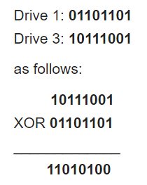
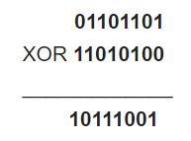

RAID Levels (Cont.)
RAID Level 2: Memory-Style Error-Correcting-Codes (ECC) with bit striping.
  What are parity bits?
P indicates error-correcting bits
[1] https://en.wikipedia.org/wiki/Parity_bit

Slide 44
RAID Levels (Cont.)
RAID Level 3: Bit-Interleaved Parity
  a single parity bit is enough for error correction, not just detection, since we know which disk has failed
    When writing data, corresponding parity bits must also be computed and written to a parity bit disk
  Faster data transfer than with a single disk, but fewer I/Os per second since every disk has to participate in every I/O
  Subsumes Level 2 (provides all its benefits, at lower cost)

Slide 45
RAID Levels (Cont.)
RAID Level 4: Block-Interleaved Parity;
  uses block-level striping, and keeps a parity block on a separate disk for corresponding blocks from N other disks.
  When writing data block, corresponding block of parity bits must also be computed and written to parity disk

Slide 46
RAID Levels (Cont.)
RAID Level 4 (Cont.)
  Provides higher I/O rates for independent block reads than Level 3
    block read goes to a single disk, so blocks stored on different disks can be read in parallel
  Provides high transfer rates for reads of multiple blocks than no-striping
  Before writing a block, parity data must be computed
      More efficient for writing large amounts of data sequentially
  Parity block becomes a bottleneck for independent block writes since every block write also writes to parity disk

Slide 47

RAID Levels (Cont.)
RAID Level 5: Block-Interleaved Distributed Parity;
  partitions data and parity among all N + 1 disks, rather than storing data in N disks and parity in 1 disk.
  E.g., with 5 disks, parity block for nth set of blocks is stored on disk (n mod 5) + 1, with the data blocks stored on the other 4 disks.

Slide 48
RAID Levels (Cont.)
RAID Level 5 (Cont.)
  Higher I/O rates than Level 4
    Block writes occur in parallel if the blocks and their parity blocks are on different disks.
  Subsumes Level 4: provides same benefits, but avoids bottleneck of parity disk

Slide 49
RAID Levels (Cont.)
RAID Level 6: P+Q Redundancy scheme;
  similar to Level 5, but stores extra redundant information to guard against multiple disk failures
  Better reliability than Level 5 at a higher cost; not used as widely.

Slide 50

Figure 10.03

Slide 51
Choice of RAID Level
Factors in choosing RAID level:
  Monetary cost
  Performance: Number of I/O operations per second, and bandwidth during normal operation
  Performance during failure
  Performance during rebuild of failed disk
    Including time taken to rebuild failed disk

Slide 52
Choice of RAID Level
RAID 0 is used only when data safety is not important
  E.g. data can be recovered quickly from other sources
Level 2 and 4 never used since they are subsumed by 3 and 5
Level 3 is not used anymore since bit-striping forces single block reads to access all disks, wasting disk arm movement, which block striping (level 5) avoids
Level 6 is rarely used since levels 1 and 5 offer adequate safety for most applications

Slide 53
Choice of RAID Level (Cont.)
Level 1 provides much better write performance than level 5
  Level 5 requires at least 2 block reads and 2 block writes to write a single block, whereas Level 1 only requires 2 block writes
  Level 1 preferred for high update environments such as log disks
Level 1 has higher storage cost than level 5
  I/O requirements have increased greatly, e.g. for Web servers
  When enough disks have been bought to satisfy required rate of I/O, they often have spare storage capacity
    so there is often no extra monetary cost for Level 1!
Level 5 is preferred for applications with low update rate,
and large amounts of data
Level 1 is preferred for all other applications

Slide 54
Hardware Issues
Software RAID: RAID implementations done entirely in software, with no special hardware support
Hardware RAID: RAID implementations with special hardware
  Use non-volatile RAM to record writes that are being executed
  Beware: power failure during write can result in corrupted disk
    E.g. failure after writing one block but before writing the second in a mirrored system
    Such corrupted data must be detected when power is restored
      Recovery from corruption is similar to recovery from failed disk

Slide 55
Hardware Issues (Cont.)
Latent failures: data successfully written earlier gets damaged
  can result in data loss even if only one disk fails
Data scrubbing:
  continually scan for latent failures, and recover from copy/parity
Hot swapping: replacement of disk while system is running, without power down
  Supported by some hardware RAID systems,
  reduces time to recovery, and improves availability greatly

Slide 56
Hardware Issues (Cont.)
Many systems maintain spare disks which are kept online, and used as replacements for failed disks immediately on detection of failure
  Reduces time to recovery greatly
Many hardware RAID systems ensure that a single point of failure will not stop the functioning of the system by using
  Redundant power supplies with battery backup
  Multiple controllers and multiple interconnections to guard against controller/interconnection failures

Slide 57
File Organization, Record Organization and Storage Access

Slide 58

File Organization
The database is stored as a collection of files.
Each file is a sequence of records.
A record is a sequence of fields.
Why do we need to learn about file organization?

Slide 59
Fixed-Length Records
Type instructor = record
ID varchar (5)
name varchar (20)
dept_name varchar (20)
salary numeric (8,2)
end;

Slide 60
Fixed-Length Records
Simple approach:
  Store record i starting from byte n ∗ (i – 1), where n is the size of each record.
  Record access is simple but records may cross blocks
    Modification: do not allow records to cross block boundaries
What about
deleting records?

Slide 61
Fixed-Length Records
Deletion of record i: alternatives:

Slide 62

Alternative 1: Deleting record 3 and compacting
Pros and cons?

Slide 63

Alternative 2: Deleting record 3 and moving last record
Pros and cons?

Slide 64

Alternative 3: Free Lists
Store the address of the first deleted record in the file header.
Use this first record to store the address of the second deleted record, and so on
Can think of these stored addresses as pointers since they “point” to the location of a record.
More space efficient representation: reuse space for normal attributes of free records to store pointers. (No pointers stored in in-use records.)
Pros and cons?

Slide 65
Variable-Length Records
Can you think of a scenario where we would need variable-length records instead of fixed-length records?
  Storage of multiple record types in a file.
  Record types that allow variable lengths for one or more fields such as strings (varchar)
  Record types that allow repeating fields (arrays or multisets - used in some older data models).
What are the challenges involved in using variable-length records?
1) How to represent a single record in such a way that individual attributes can be extracted easily?
2) How to store variable-length records within a block, such that records in a block can be extracted easily?

Slide 66

Variable-Length Records
Attributes are stored in order
Variable length attributes represented by fixed size (offset, length), with actual data stored after all fixed length attributes
Type instructor = record
ID varchar (5)
name varchar (20)
dept_name varchar (20)
salary numeric (8,2)
end;

Slide 67
Variable-Length Records
What if the attribute value is null?
Null values represented by null-value bitmap
Type instructor = record
ID varchar (5)
name varchar (20)
dept_name varchar (20)
salary numeric (8,2)
end;

Slide 68

Variable-Length Records: Slotted Page Structure
Slotted page header contains:
  number of record entries
  end of free space in the block
  location and size of each record
Records can be moved around within a page to keep them contiguous with no empty space between them; entry in the header must be updated.
Pointers should not point directly to record — instead they should point to the entry for the record in header.
How does insertion and deletion work?

Slide 69
Organization of Records in Files
Heap – a record can be placed anywhere in the file where there is space
Sequential – store records in sequential order, based on the value of the search key of each record
Hashing – a hash function computed on some attribute of each record; the result specifies in which block of the file the record should be placed

Slide 70

Sequential File Organization
Suitable for applications that require sequential processing of the entire file
The records in the file are ordered by a search-key

Slide 71

Sequential File Organization (Cont.)
Deletion – use pointer chains
Insertion –locate the position where the record is to be inserted
  if there is free space insert there
  if no free space, insert the record in an overflow block
  In either case, pointer chain must be updated
Need to reorganize the file
from time to time to restore
sequential order

Slide 72
Column-oriented Storage (Section 20.2.3)
Traditional databases store data in a row-oriented manner
  All attributes of a tuple are stored together in a file, and
  Tuples are stored sequentially in a file
  What happens when you ask for the average salary of all instructors?

Slide 73
Column-oriented Storage (Section 20.2.3)
In column-oriented storage,
  Each attribute of a relation is stored in a separate file, but
  Values from successive tuples are stored at successive positions in the file
  What are the pros and cons of this approach?

Slide 74
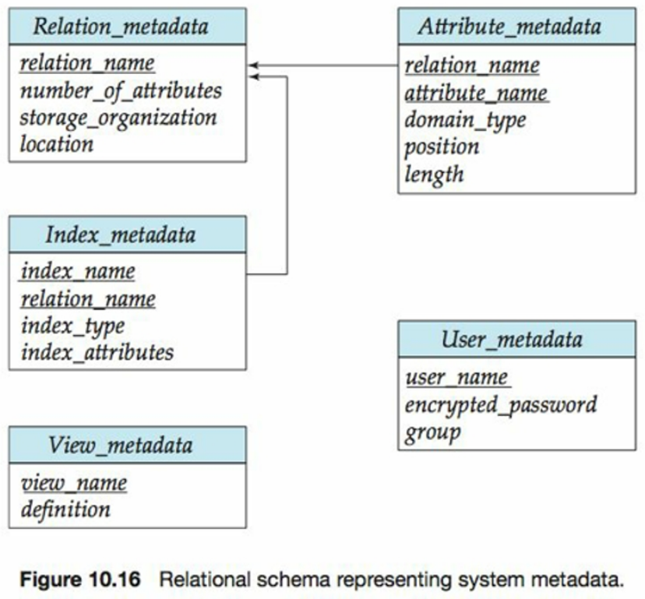
Data Dictionary Storage

Slide 75
Data Dictionary Storage
The Data dictionary (also called system catalog) stores metadata; that is, data about data, such as
Information about relations
  names of relations
  names, types and lengths of attributes of each relation
  names and definitions of views
  integrity constraints
Physical file organization information
  How relation is stored (sequential/hash/…)
  Physical location of relation
Information about indices (Chapter 11)

Slide 76
Storage Access
A database file is partitioned into fixed-length storage units called blocks. Blocks are units of both storage allocation and data transfer.
Database system seeks to minimize the number of block transfers between the disk and memory. We can reduce the number of disk accesses by keeping as many blocks as possible in main memory.
Buffer – portion of main memory available to store copies of disk blocks.
Buffer manager – subsystem responsible for allocating buffer space in main memory.

Slide 77
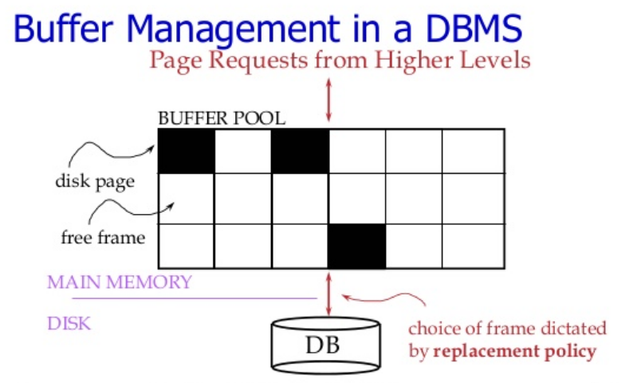
Buffer Manager
[1] https://www.slideshare.net/computerheartofus/buffer-manager

Slide 78
Buffer-Replacement Policies (Cont.)
Buffer manager partitions the available memory into a collection of pages, which are collectively referred to as the buffer pool
  The main memory pages in the buffer pool are called frames
Buffer manager stores 2 variables for each frame in the pool
  pin_count (int)
    The number of times that the page currently has been requested but not released (i.e. the number of current users of the page).
    Incrementing pin_count is often called pinning the requested page in the frame
  dirty (boolean)
    Indicates whether the page has been modified since it was brought into the buffer from the disk
Pinned block – memory block that is not allowed to be written back to disk

Slide 79
Buffer Manager
Programs call on the buffer manager when they need a block from disk.
  If the block is already in the buffer, buffer manager returns the address of the block in main memory
  If the block is not in the buffer, the buffer manager
    Allocates space in the buffer for the block
      Replacing (throwing out) some other block, if required, to make space for the new block.
      Replaced block written back to disk only if it was modified (i.e. the dirty bit is set to 1), since the most recent time that it was written to/fetched from the disk.
    Reads the block from the disk to the buffer, and returns the address of the block in main memory to requester.

Slide 80
Buffer-Replacement Policies
Most operating systems replace the block least recently used (LRU strategy)
Idea behind LRU – use past pattern of block references as a predictor of future references
This strategy works well for operating systems, but not for database systems
  Why?
  Queries have well-defined access patterns (such as sequential scans), and a database system can use the information in a user’s query to predict future references

Slide 81
Buffer-Replacement Policies
LRU can be a bad strategy for certain access patterns involving repeated scans of data
  For example: when computing the join of 2 relations by using nested loops join
  Mixed strategy with hints on replacement strategy provided
  by the query optimizer is preferable

Slide 82
Buffer-Replacement Policies (Cont.)
Most recently used (MRU) strategy – system must pin the block currently being processed. After the final tuple of that block has been processed, the block is unpinned, and it becomes the most recently used block.
Buffer manager can use statistical information regarding the probability that a request will reference a particular relation
  E.g., the data dictionary is frequently accessed. Heuristic: keep data-dictionary blocks in main memory buffer

Slide 83
End of Chapter 10

